Slide 1

Object-Oriented Software Analysis & Design (COMP-3220) Lecture 7 Adapter and Facade Patterns
School of Computer Science
Faculty of Science
University of Windsor
Dr. Saeed Samet

Slide 2
Adapter Pattern

Slide 3
Intent
The Adapter Pattern converts the interface of one class into another interface that a client expects.
It allows classes with incompatible interfaces to work together without modifying their existing code.

Slide 4
Motivation
In object-oriented systems, we often reuse existing classes or third-party libraries. However, the interfaces of those classes may not match the interface expected by the client code.
Instead of changing the existing code, the Adapter Pattern acts as a bridge between the incompatible interfaces.

Slide 5
Problems It Solves
Reusing legacy code without modifying it.
Integrating third-party libraries.
Allowing incompatible interfaces to collaborate.
Reducing changes in existing client code.

Slide 6
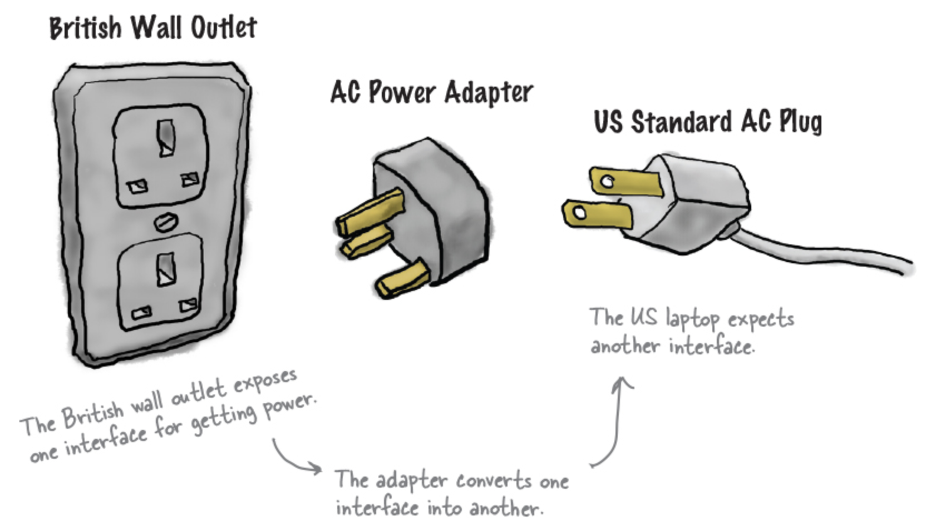
Real-Life Analogy
A phone charger adapter allows a device from one country to plug into a different electrical outlet standard.
Your phone expects one interface.
The wall outlet provides another interface.
The adapter converts one interface into another.

Slide 7
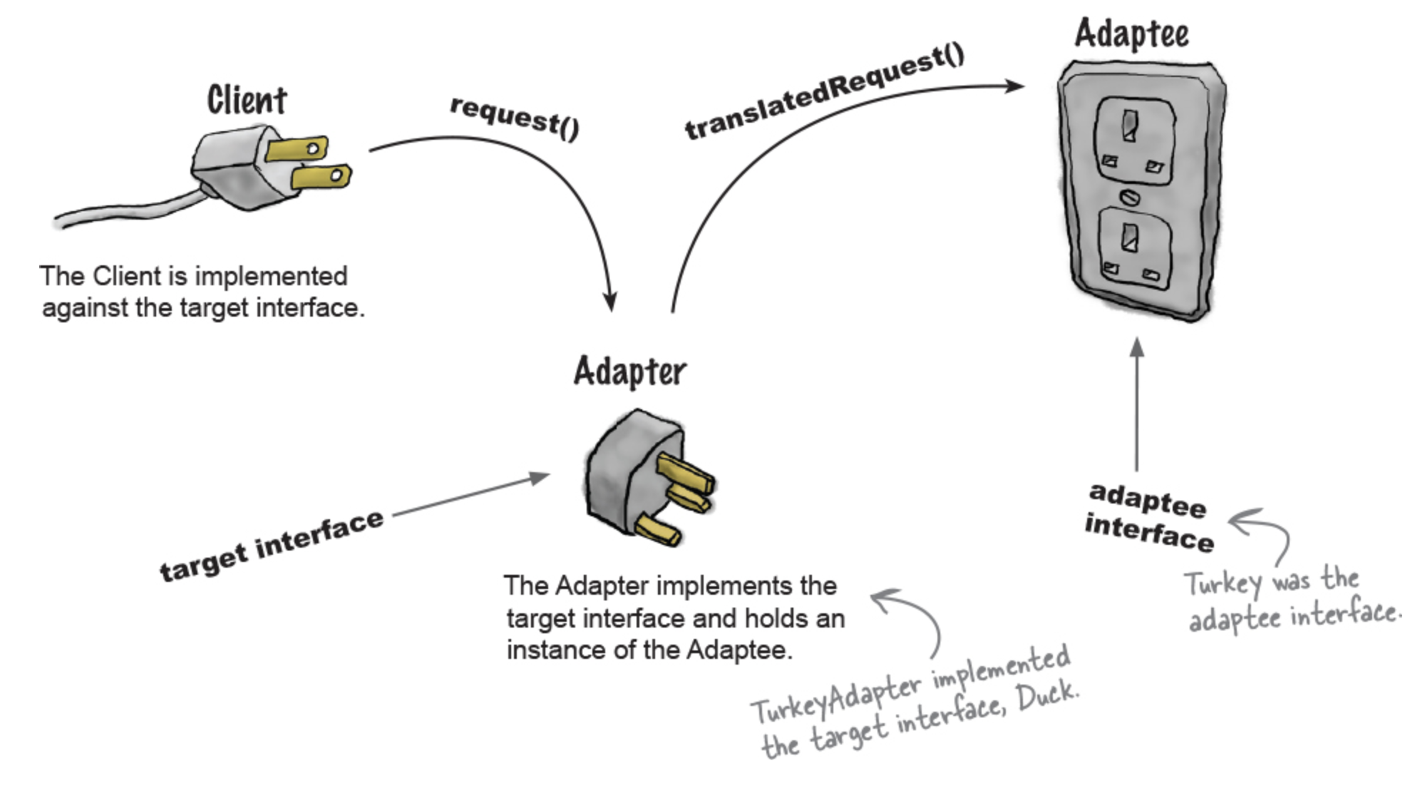
Real-Life Analogy

Slide 8
Adapter Pattern Structure
Main Participants
Target
The interface expected by the client.
Adaptee
The existing class with an incompatible interface.
Adapter
Converts the Adaptee interface into the Target interface.
Client
Uses the Target interface.

Slide 9
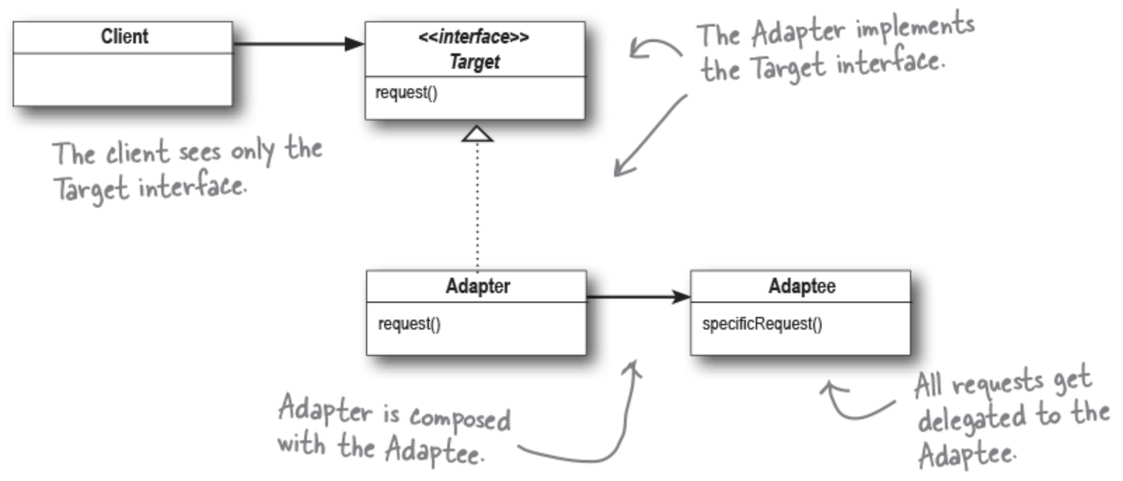
Adapter Pattern – Class Diagram

Slide 10
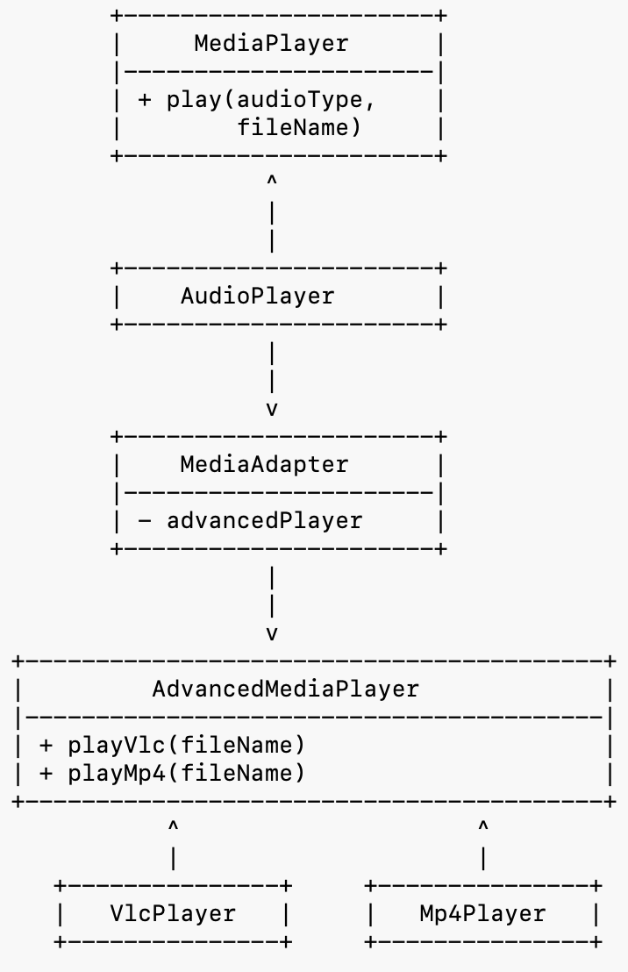
Example: Media Player Adapter
Suppose:
Our application supports MP3 files.
A third-party library plays VLC files.
The interfaces are incompatible.
We use an Adapter so the
application can play VLC files
through the same interface.

Slide 11
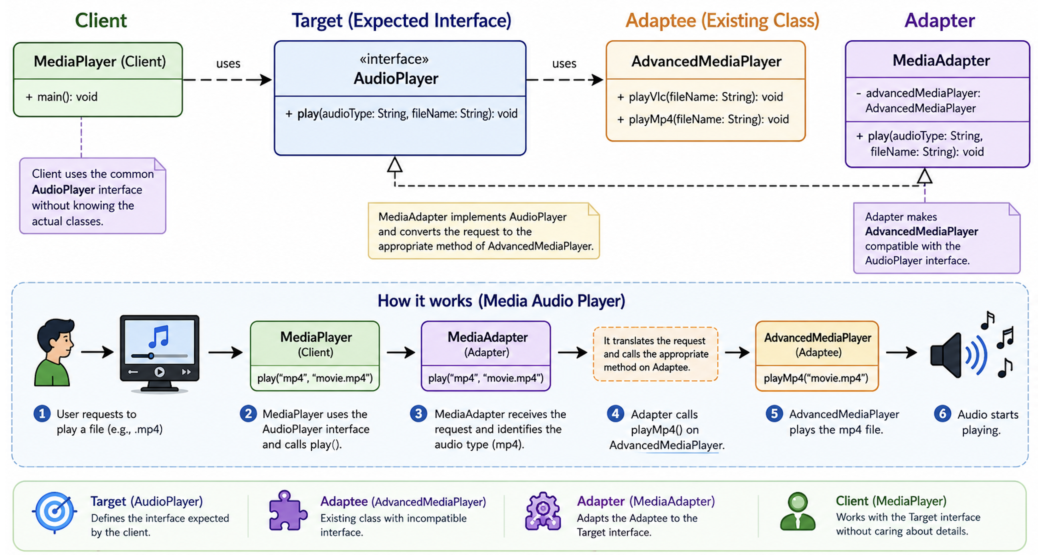
Media Player Adapter

Slide 12
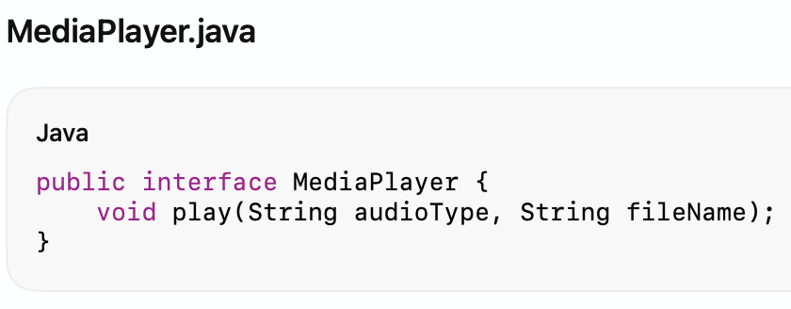
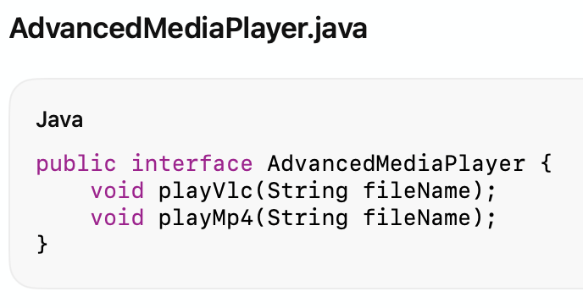
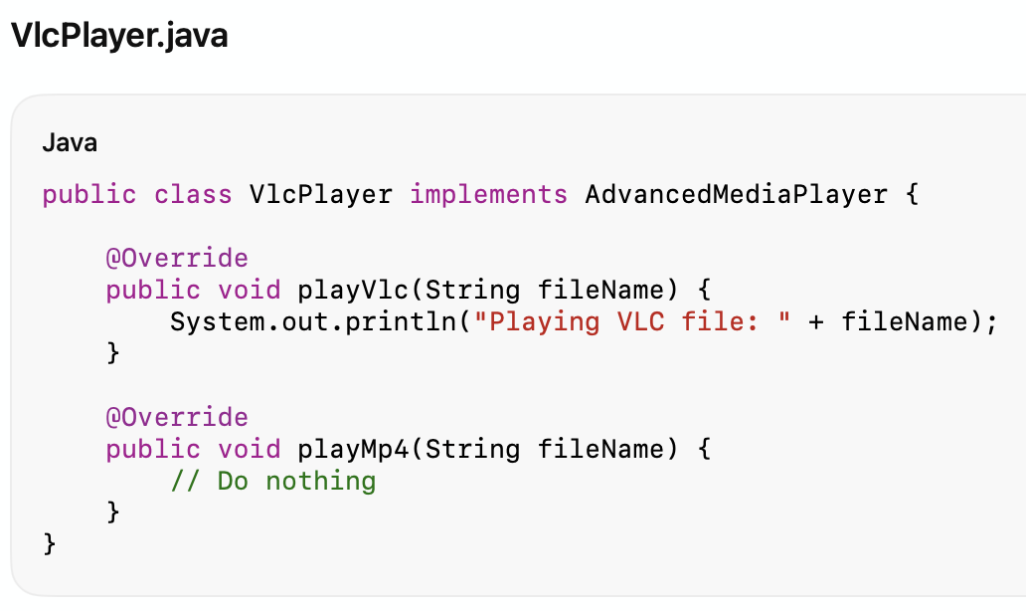
Java Code

Slide 13
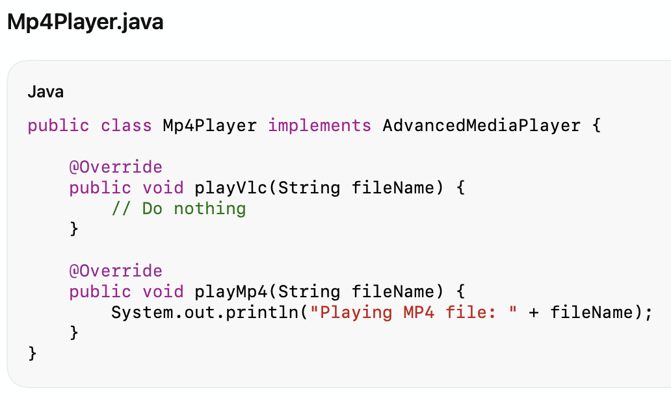
Java Code

Slide 14
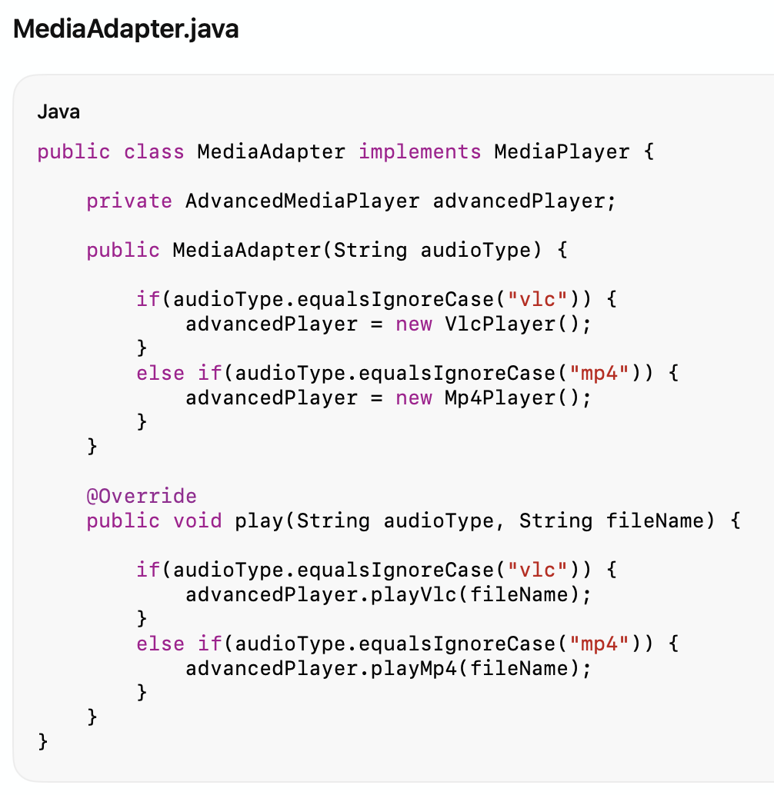
Java Code

Slide 15
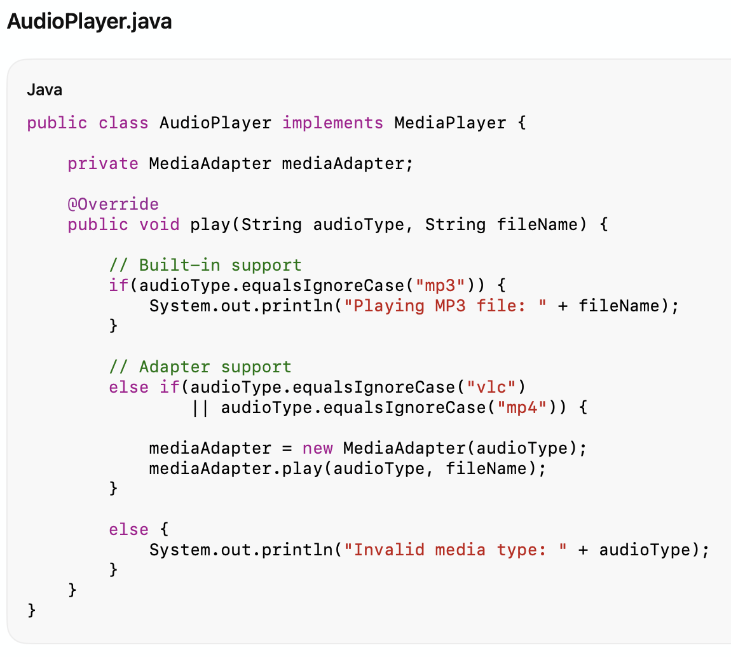
Java Code

Slide 16
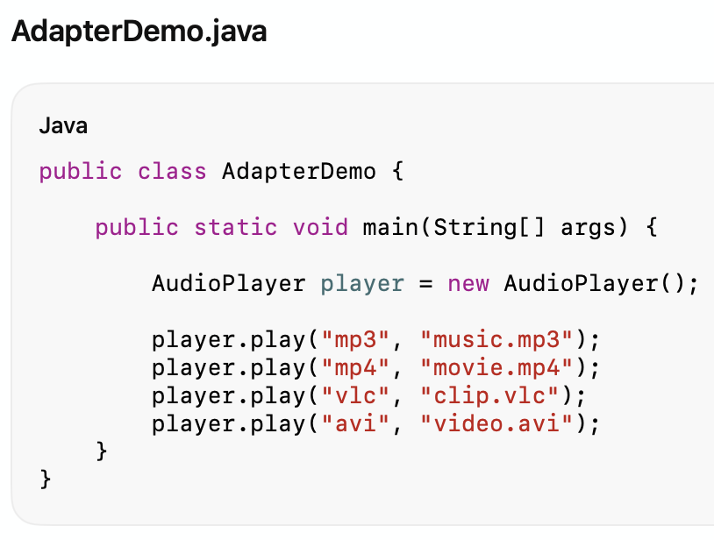
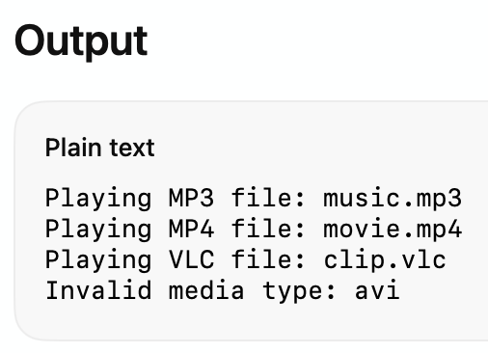
Java Code

Slide 17
Advantages & Disadvantages
Advantages of Adapter Pattern
Promotes code reuse.
Supports Open/Closed Principle.
Avoids modifying legacy code.
Makes incompatible classes collaborate.
Disadvantages
Adds additional abstraction layers.
Too many adapters may increase complexity.

Slide 18
When use Adapter Pattern
You want to integrate an existing class into a new system.
Existing interfaces are incompatible.
You cannot modify the reused component.
You want backward compatibility.

Slide 19
Facade Pattern

Slide 20
Intent
The Facade Pattern provides a simplified unified interface to a set of interfaces in a subsystem.
Instead of interacting with many complex classes directly, the client interacts with a single Facade object.

Slide 21
Motivation
Complex systems often contain many interacting classes.
Clients may need to know:
Which classes to create.
In what order methods should be called.
How objects collaborate internally.
This increases coupling and complexity.
The Facade Pattern hides subsystem complexity behind a simple interface.

Slide 22
Problems It Solves
Reduces coupling between client and subsystem.
Simplifies usage of complex systems.
Provides a cleaner high-level API.
Hides implementation details.

Slide 23
Real-Life Analogy
A hotel reception desk acts as a facade. Instead of contacting:
housekeeping,
room service,
maintenance,
restaurant,
individually, the guest talks only to reception.
The reception coordinates everything internally.

Slide 24
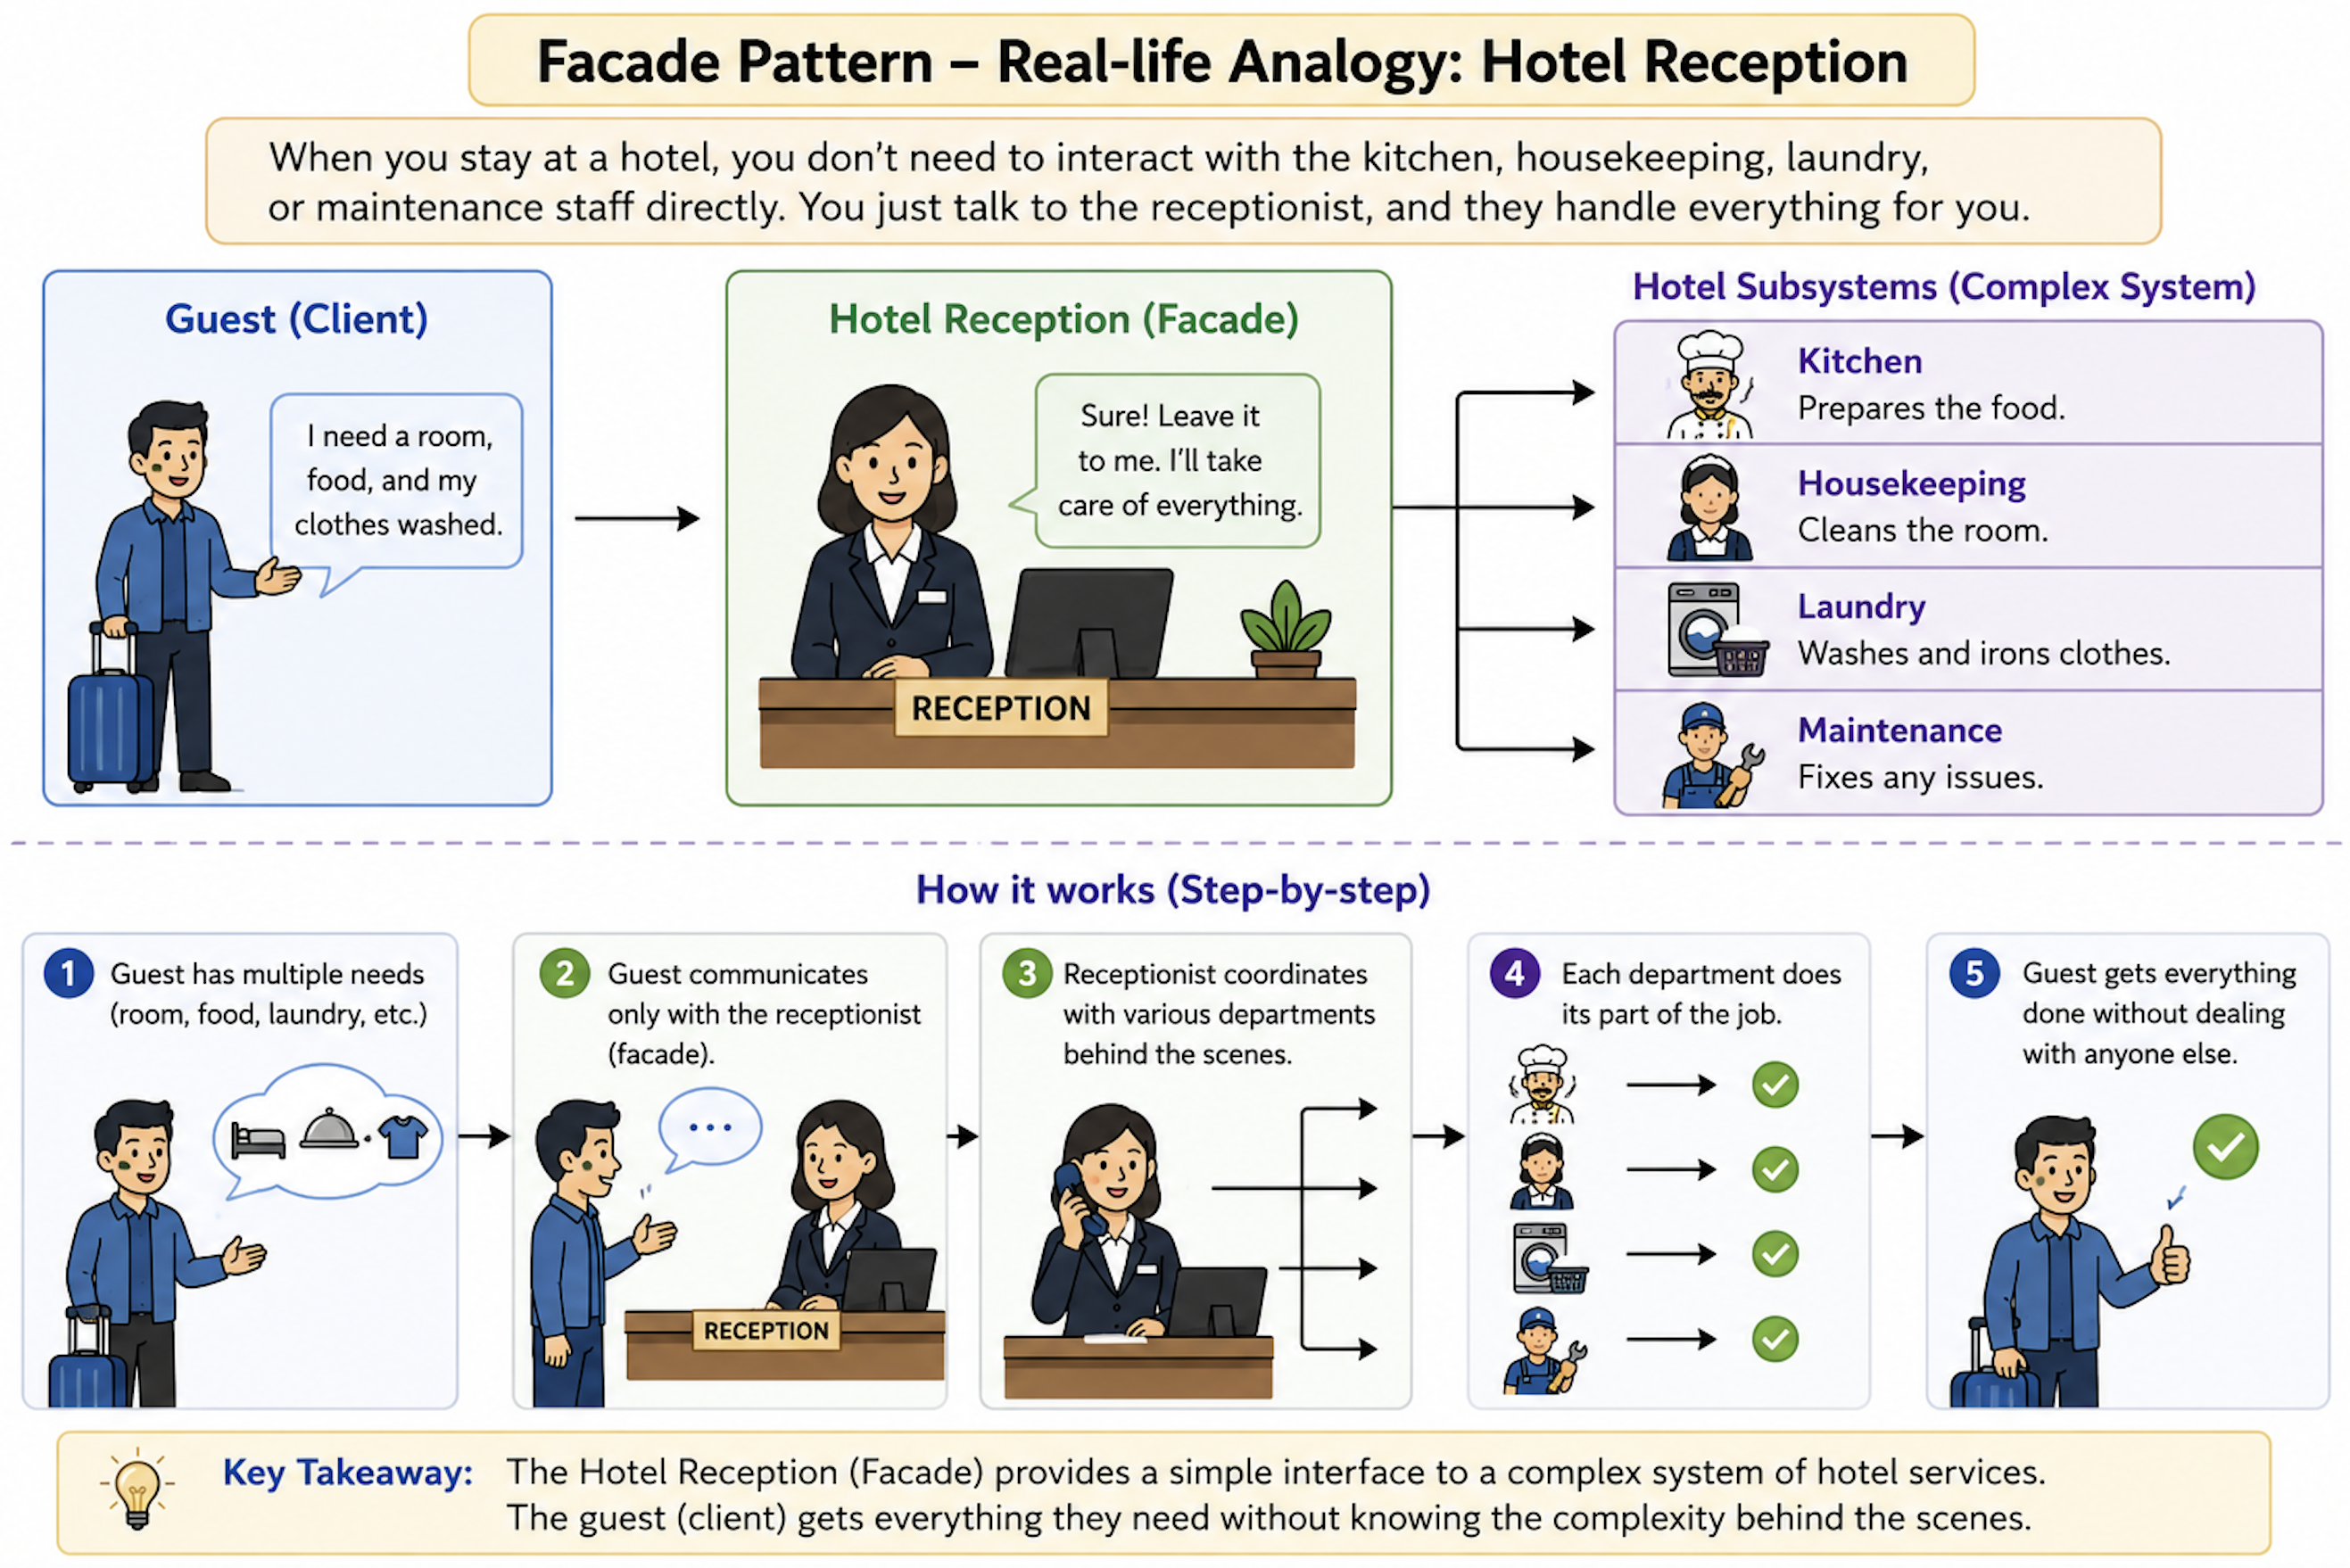
Real-Life Analogy

Slide 25
Facade Pattern Structure
Main Participants
Facade
Provides a simplified interface.
Subsystem Classes
Perform the actual work.
Client
Uses the Facade instead of directly using subsystem classes.

Slide 26
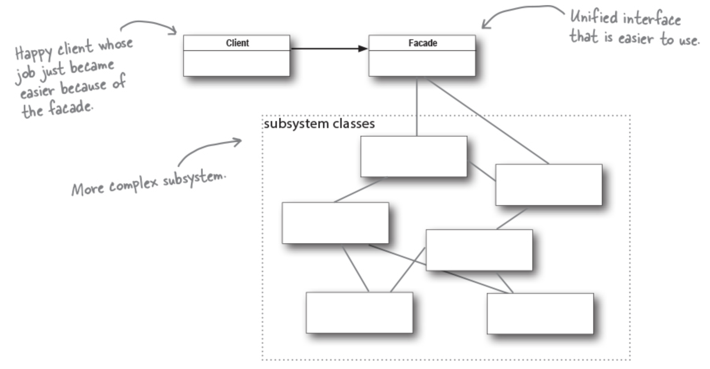
Facade Pattern – Class Diagram

Slide 27
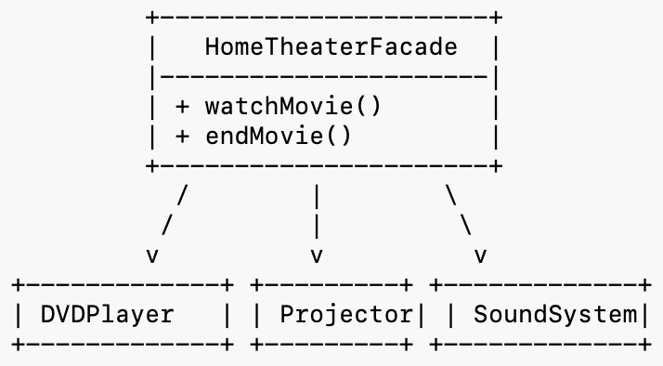
Example: Home Theater System
Suppose a home theater requires interacting with:
DVD Player
Projector
Sound System
Lights
Without a facade, the client must control all components
individually.
With a facade, a single method such as watchMovie() handles everything.

Slide 28
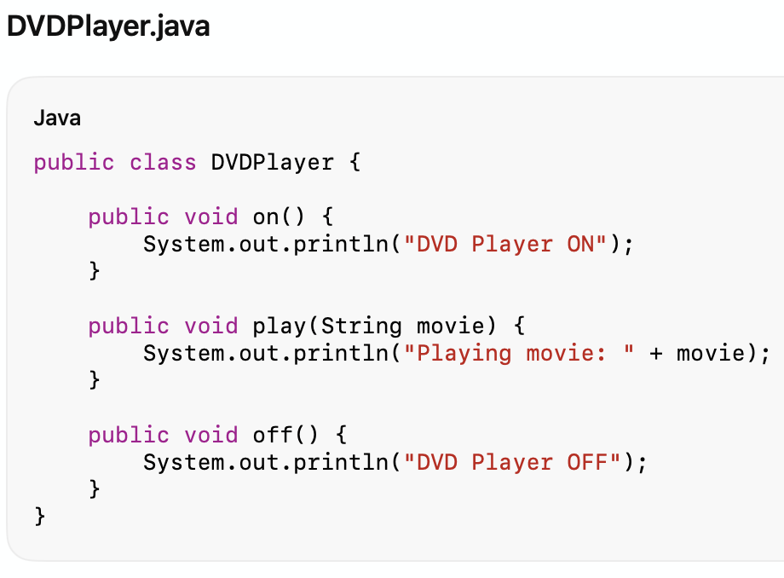
Java Code

Slide 29
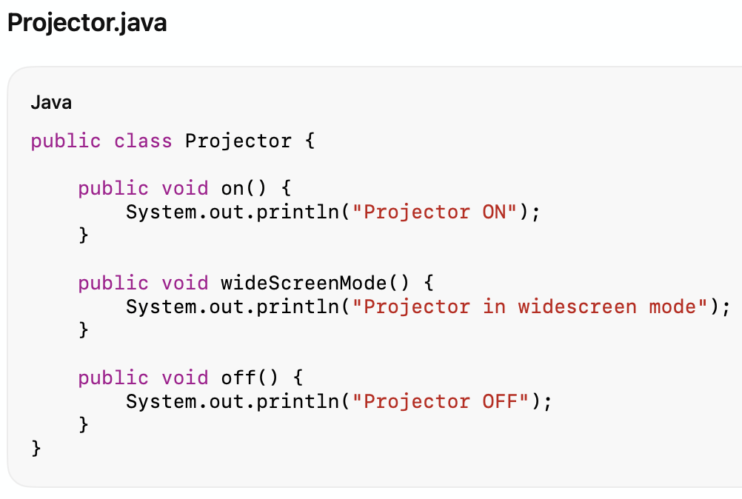
Java Code

Slide 30
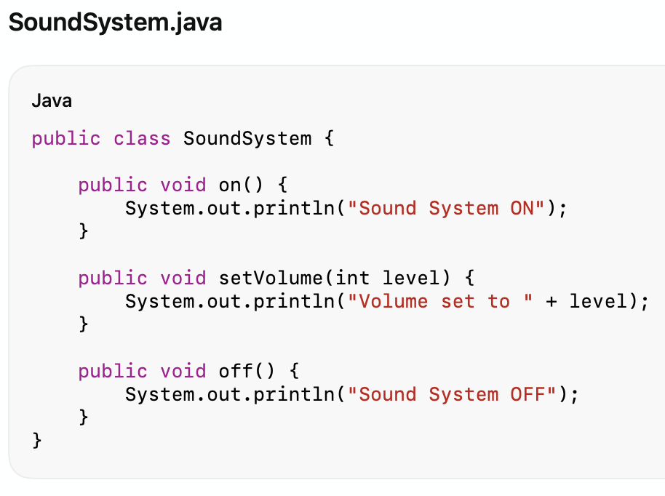
Java Code

Slide 31
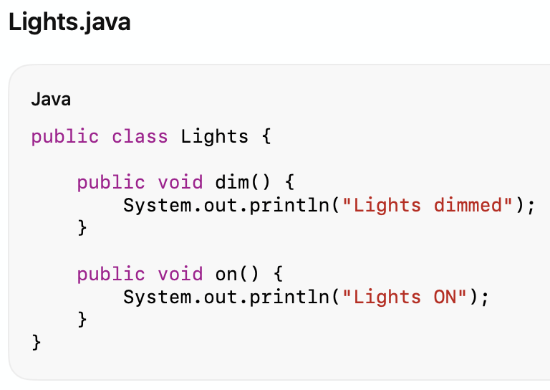
Java Code

Slide 32
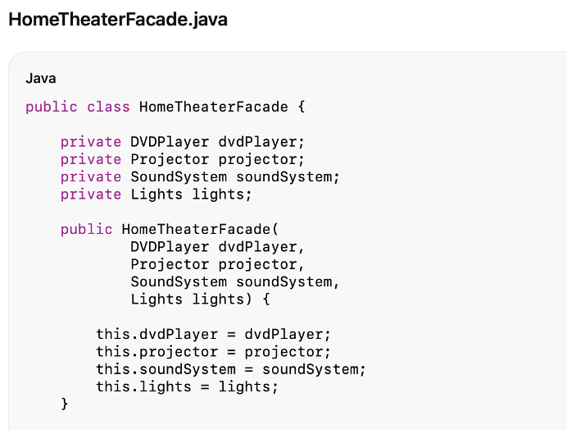
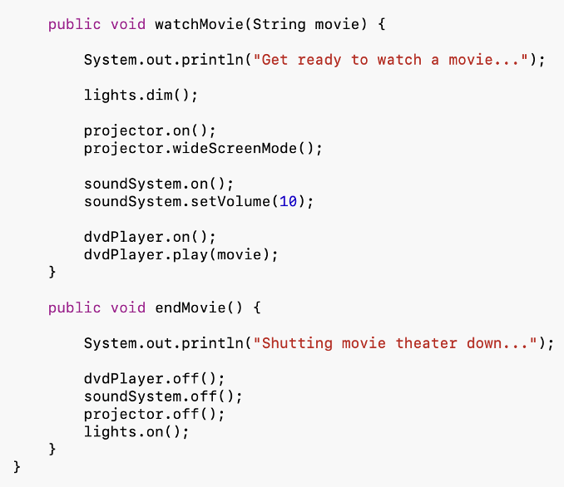
Java Code

Slide 33
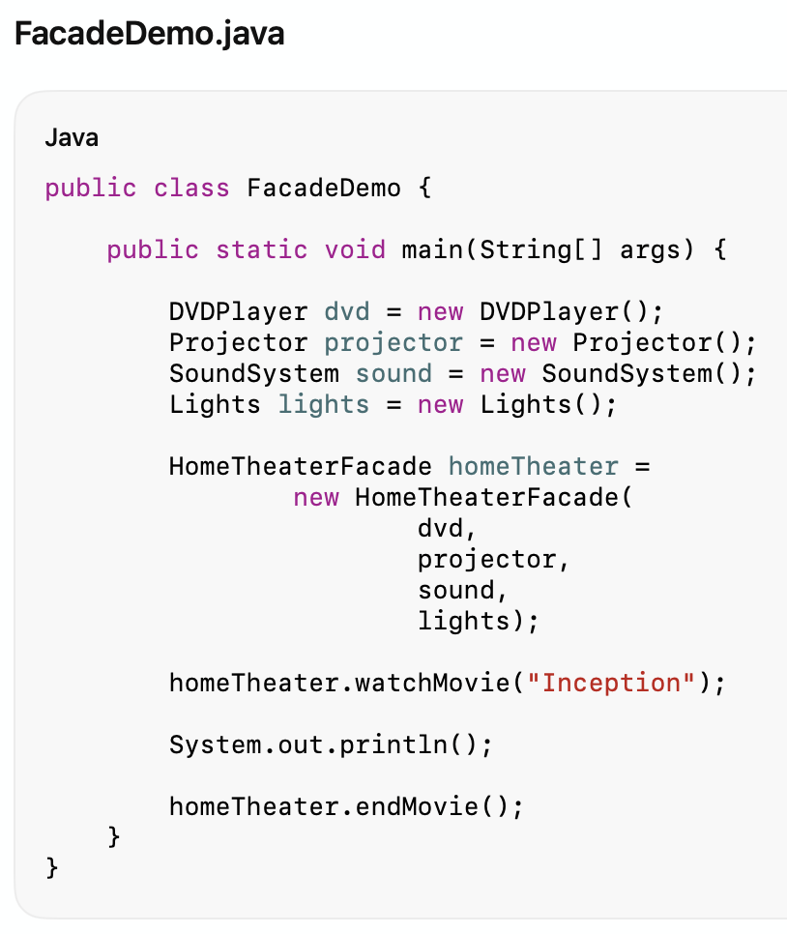
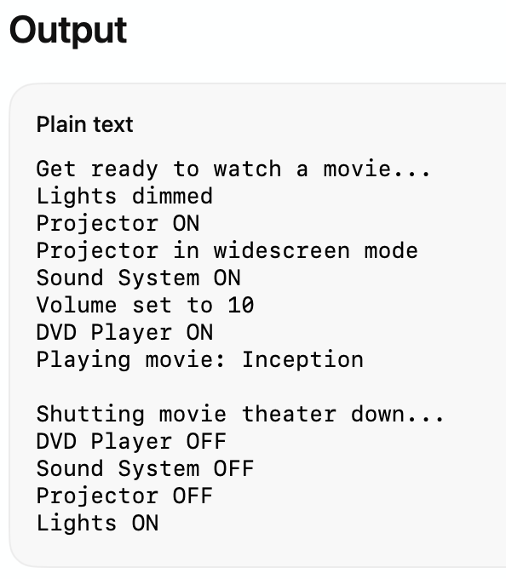
Java Code

Slide 34
Advantages & Disadvantages
Advantages of Facade Pattern
Simplifies client usage.
Reduces coupling.
Encapsulates subsystem complexity.
Improves readability and maintainability.
Disadvantages
Facade may become too large (“God Object”).
Can hide useful subsystem functionality.

Slide 35
When use Facade Pattern
A subsystem is complex.
You want a simpler API.
You want to reduce dependencies.
You want layered architecture boundaries.

Slide 36
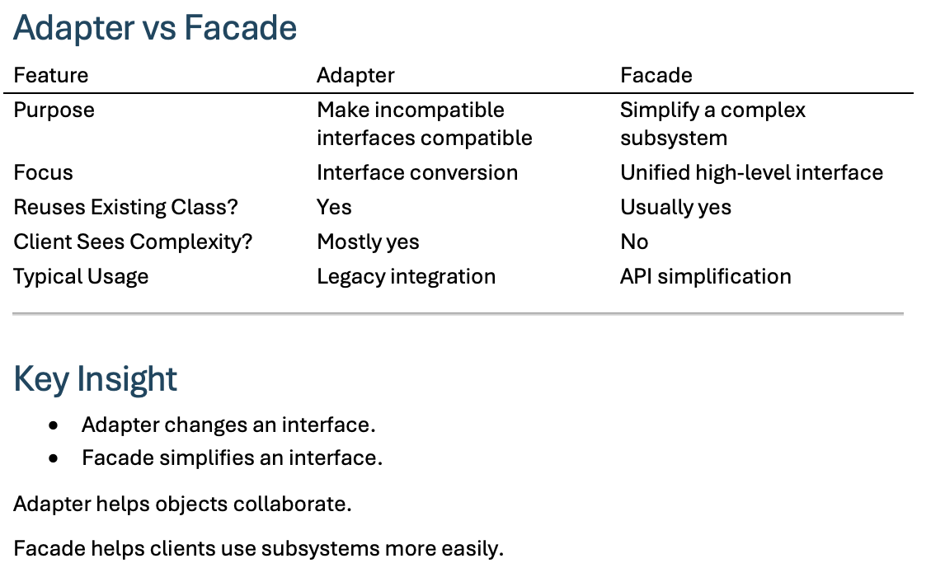
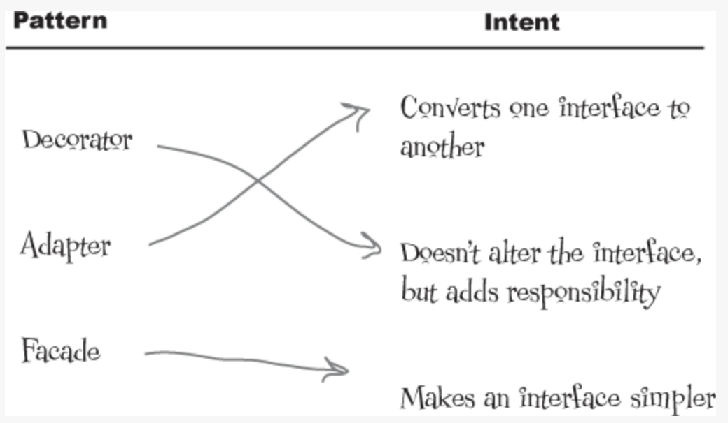
Summary

